Slide 1
Time complexity: Few more examples and Best, Worst and Average case time complexity

Slide 2
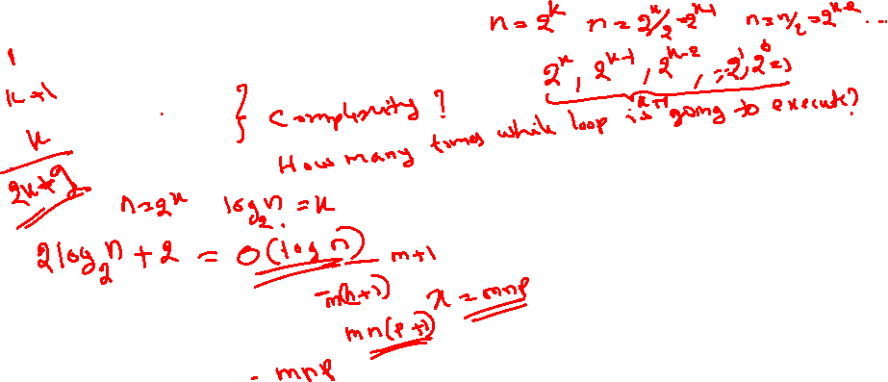
Step Count Method: Few more examples
int n; \\ assume n as power of 2
while (n>1)
n=n/2;
2. int x=0;
for(int i=0; i<m; i++)
for (int j=0; j<n; j++)
for(int k=0; k<p; k++)
x = x+1;
What is the final value of x? how many times for loop for k will execute?

Slide 3
Step Count Method: Few more examples
double n; \\ assume n =2^{k} and k as power of 2
while (n>=2)
n=sqrt(n);
int a = 0;
for (i = 0; i < N; i++) {
for (j = N; j > i; j--) {
a = a + i + j;
}
}

Slide 4
Recursive Algorithms
int rSum (int a[], int n)
{
if (n > 0)
return Rsum(a, n-1) + a[n-1];
return 0;
}
Let t_{rSum}(n) denote total step count of finding rSum(a, n). Then t_{rSum}(n) = t_{rSum}(n-1) + 2
and
Base case is t_{rSum}(0) = 2
Therefore, time complexity = O(n)

Slide 5
Recursive Algorithm Contd.
Int RSequentialSearch(int a[], int n, const int& x)
{
if ( n < 1) return -1;
if (a[n-1] == x) return n-1;
return RSquentialSearch(a n-1, x);
}
Let t_{RSequentialSearch}(n) = t_{RSequentialSearch}(n-1) + 3 and
Base case is t_{RSequentialSearch}(0) = 2
T(n) = t(n-1)+3
= [t(n-2)+3] + 3
…..
…..
= t(n-n) + 3n
= 2 + 3n = O(n)

Slide 6
Problem: What is the time complexity of recursive function for finding n factorial?

Slide 7
Best, Worst and Average Case Time Complexity

Slide 8
Best, Worst and Average Case Complexity
Depends on the problem we need to decide, which is the best case, worst case and average case for the given problem.

Slide 9
Best case for sequential search: Element found at first place.
Int SequentialSearch(int a[], int n, const int& x)
{
int i;
for (i = 0; i < n && a[i] != x; i++);
if (i == n) return -1;
else return i;
}
No. of steps

Slide 10
Worst case for sequential search: Element not found/element found at last place.
Int SequentialSearch(int a[], int n, const int& x)
{
int i;
for (i = 0; i < n && a[i] != x; i++);
if (i == n) return -1;
else return i;
}
No. of steps

Slide 11
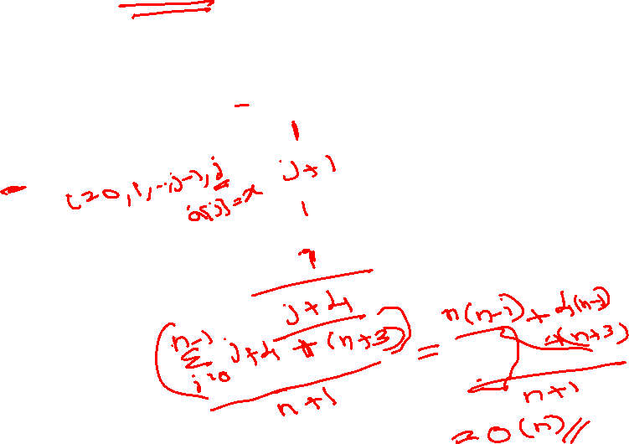
Average case for sequential search: Element found at position j. (i.e., a[j]=x)
Int SequentialSearch(int a[], int n, const int& x)
{
int i;
for (i = 0; i < n && a[i] != x; i++);
if (i == n) return -1;
else return i;
}
No. of steps
= [0 + 1 + 2 +… +(n-1) + 4 n + (n+3) ] / (n+1)

Slide 12
Best case for Inserting an element into sorted array: Element is inserted at last position.
void insert(int a[], int n, int x)
{
int i;
for (i = n - 1; i >= 0 && x < a[i]; i--)
a[i+1] = a[i];
a[i+1] = x; // insert x
}
No. of steps

Slide 13
Average case for Inserting an element into sorted array: Element is inserted at j^{th} position i.e., a[j]=x.
void insert(int a[], int n, int x)
{
int i; 1
for (i = n - 1; i >= 0 && x < a[i]; i--) n-j+1
a[i+1] = a[i]; n-j
a[i+1] = x; // insert x 1
}
Total Steps: 2n-2j+3
No. of steps
Average case complexity = [ ∑₀^{n} (2n-2j+3) ] / (n+1) = 2n - n + 3 = n+3 = O (n)

Slide 14
What is the best, worst and average case time complexity of selection and bubble sort?
void bubbleSort(int a[], int n)
{
for (int i = n; i > 1; i--)
{
for (int j = 0; j < i - 1; j++)
{
if (a[j] > a[j+1]) swap(a[j], a[j + 1]);
}
}
}
For the given bubble sort algorithm, it takes O(n²) time for best case. But is it possible to make it O(n) for best case scenario? think the modification! What if you keep count on swaps?

Slide 15
Practical Complexities
10⁹ instructions/second

Slide 16
Impractical Complexities
10⁹ instructions/second

Slide 17
Faster Computer Vs Better Algorithm
Algorithmic improvement more useful
than hardware improvement.
E.g. 2^{n} to n³

Slide 18
Reference:
Sartaj Sahani, Data Structures Algorithms and Applications in C++, Second Edition, Universities Press (India) Private Ltd, 2005.

Slide 19
Thank You

